Slide 1
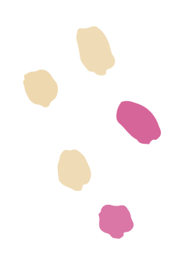
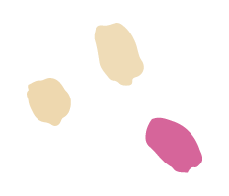
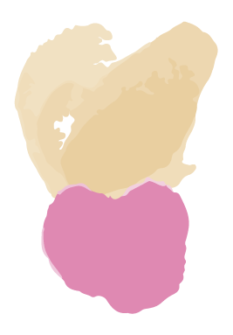

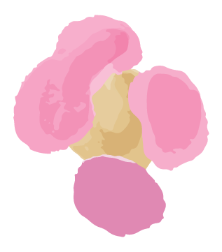
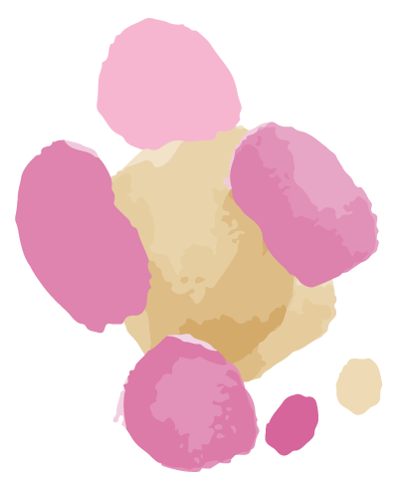


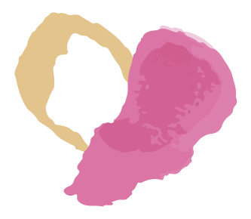
SkinLens
Team Biased
Your Personal Dermatologist

Slide 2
AGENDA
01
02
03
04
05
06
Problem Statement
Project Description Personas
MVP
Technologies and Algorithms
Project Schedule Team Working Agreement
Sprint Retrospective

Slide 3
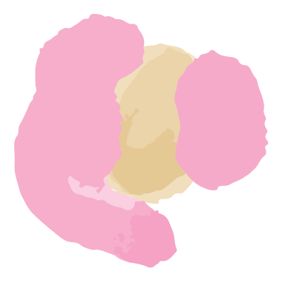
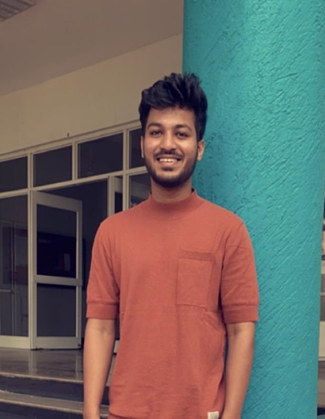
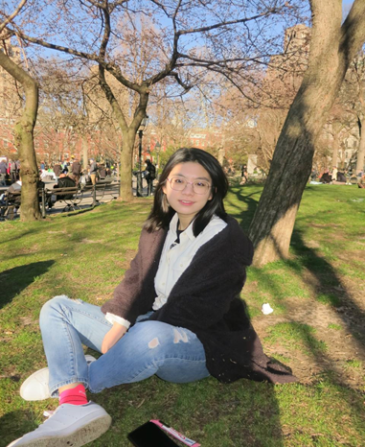
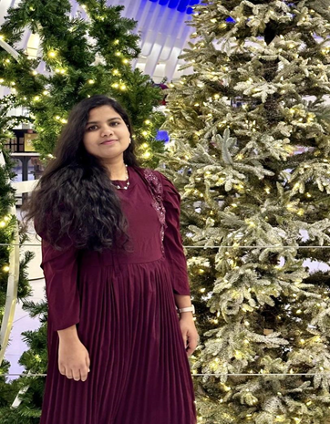

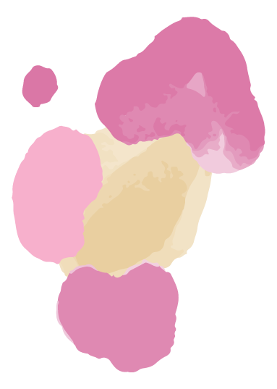
Roles and Responsibilities
MOHAMMAD ZAID
TEAM LEADER/DEVELOPER
ZHUOWEN YAN
SCRUM MASTER/DEVELOPER
NAGANJALI PUJITHA KALLI
DBA/DEVELOPER

Slide 4
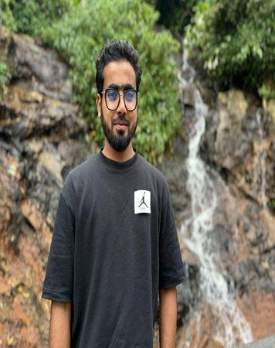
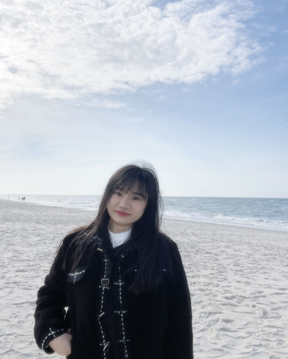
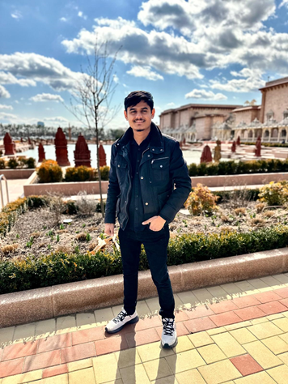
Roles and Responsibilities
MOHAMMED TANZIL
DEVELOPER/TESTER
BANGLING YIN
DEVELOPER
ABHI KUMAR
DEVELOPER/TESTER

Slide 5
WHAT PROBLEM ARE WE SOLVING?
Accurate and timely diagnosis of skin diseases is a challenge because:
Limited availability of dermatologists in remote areas
Traditional methods primarily involve only visual inspection of the skin which may be prone to human error or variability in interpretation.
What does it affect?
This results in delayed diagnosis, limited personal care and possibly worsening of skin diseases.

Slide 6
PROJECT DESCRIPTION
A web-based platform to help patients diagnose skin conditions using deep learning.
Intended for patients who wants to quickly access their skin conditions, skinLens integrates image analysis to provide accurate diagnosis of skin diseases and recommend treatments.
Intended for dermatologists who wants to efficiently access patient’s skin conditions.
Unlike traditional visual inspections, SkinLens uses advanced image-based deep learning model and offers accurate predictions and recommend treatments along with real-time consultation with dermatologists.
Benefits - Improved diagnose accuracy, faster and personalized care, increased accessibility, reduced costs and real-time access to consultations with dermatologists.

Slide 7
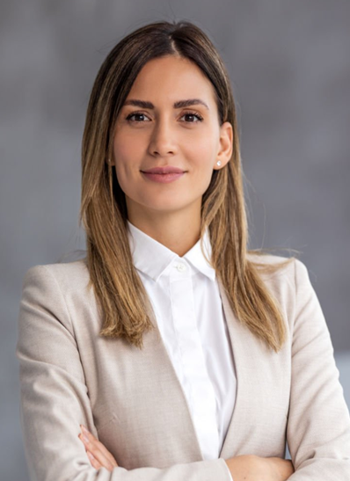
PATIENT PERSONA
Nashley Pagiroli
Age: 30
Gender: Female
Occupation: IT Employee
She is a busy professional person, living in a city and has sensitive skin prone to rash and acne.
Challenges:
●She has skin issues and often experiences delays in scheduling appointments with
dermatologists.
●Finds it challenging to describe symptoms accurately and fears misdiagnosis due to lack of knowledge.
●Concerned about long-term skin damage and wants fast treatment options.
Goals:
●She wants a reliable, easy-to-use platform to self-access skin issues quickly and get initial feedback without needing to wait for appointments.
●Hopes to receive personalized treatment recommendations based on her skin type, age, and medical history.

Slide 8
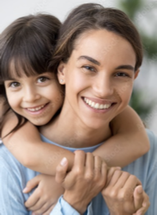
PARENT PERSONA
Gloria Garson
Age : 40
Gender : Female
Occupation : House wife
She is a housewife balancing taking care of four children,household duties, and her husband,leaving
her with little time to focus on individual healths.
Challenges:
●Frequently deals with minor skin issues like rashes or eczema among her kids.
●Finds to gets confused especially when it comes to skincare for different ages and skin types.
●Concerned about the cost and time required for multiple doctor visits, particularly for non-serious conditions.
Goals:
●Seeks personalized advice for each children skincare with their unique needs like skin type, allergies, or past treatments.
●Hopes to save time by using specific symptoms and images she uploads.
●Wants peace of mind by receiving accurate, clear advice and thinks homecare is sufficient.

Slide 9
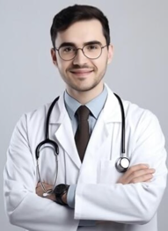
DOCTOR PERSONA
Dr.Robert
Age : 35
Gender : Male
Occupation : Dermatologist
He is working in both a hospital and private clinic, treating a high volume of patients
with various skin conditions.
Challenges:
●Manages a large patient load daily, leading to limited time for each consultation and difficulty providing personalized care.
● Often receives incomplete descriptions of symptoms, making it challenging to diagnose accurately without further testing or follow-ups.
●Struggles to track patient treatment outcomes over time,like eczema or psoriasis, due to irregular follow-ups or inconsistent data from patients.
Goals:
●Wants a platform of patient information, including symptom descriptions, images, and medical history, allowing for quick.
●Hopes to tracks patient progress over time, helping to adjust treatments.
●Aims to reduce the patient times.

Slide 10
WHAT WILL OUR MVP BE?
Web based interface
Image Processing
AI Model
Diagnosis Output
Basic user management
Mobile Responsiveness

Slide 11


















Technologies and Algorithms
Programming languages, Frameworks/Libraries:
Databases:
Tools:

Slide 12
ALGORITHMS:
CNN (Convolutional Neural Network):
CNN will be used to process and analyze the images of the patient’s skin, identifying visual patterns
Automated Feature Extraction
Localized Pattern Detection
Efficient Dimensionality Reduction
High Accuracy in Disease Classification.

Slide 13
Natural Language Processing:
Text Generation Model: We are using Hugging Face's powerful transformer models, which are pre-trained on vast amounts of text data.
Input Data: When user describes their symptoms, our system processes this information. We use NLP techniques to extract key details from the user's description.
Generating Descriptions: Using the Hugging Face text generation pipeline, we input the extracted symptoms.The model then generates a comprehensive description of the diagnosed skin condition,

Slide 14
Project Schedule
Sprint 0
Sprint 1
Sprint 2
Sprint 3
Sep 6 - Sep 26
Daily Scrum
Sep 26 - Oct 24
Daily Scrum
Oct 24 - Nov 21
Daily Scrum
Nov 21 - Dec 12
Daily Scrum

Slide 15
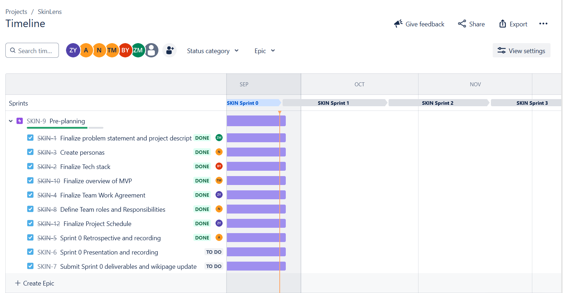
Project Schedule

Slide 16
Team Working Agreement
Communication expectations
Meeting structure and frequency
Meetings will be held via zoom
Daily scrum at 8pm for 15 minutes.
A follow-up meeting should be planned after the daily scrum if there are any blockers that can’t be addressed quickly.
A meeting for Sprint Planning will be planned at the beginning of the Sprint.
A meeting for Sprint Retrospective will be planned before the Sprint end date.
Encourage everyone to actively participate in the meeting.
We will adhere to agreed meeting time and will inform the team of any absences.
Any changes in the timings will be mutually decided.
Meeting minutes with objectives and decisions will be recorded in a Google Sheet.
If you miss a meeting, support decisions made in your absence.
Scrum Master should host the meeting and control time.
All communications will be through Slack.
Opinions and ideas of all team members will be respected.
Changes, if any, should be discussed and agreed within the team.
Conflicts should be focused on issues and not individuals. (Strictly avoid blame game)
Unresolved conflicts among the team should be reported to the team leader.
We encourage everyone to express their frustrations and discomfort early.
Clear understanding and listening to others are the most important things to resolve conflicts.

Slide 17
Team Working Agreement
Team norms and values
Continuous Improvement
Encourage teams to research, learn, come up with new ideas and share with the team.
We will reflect on areas of improvement during each Sprint Retrospective so that our process is better for the next sprint.
Each team member understands their roles and responsibilities.
We divide tasks transparently and help each other when necessary.
Each task should have a clear due date and mutually accepted definition of “Done”.
Each team member takes responsibility for their tasks and for achieving the team's goals.
Team members should report obstacles immediately if they cannot complete their work on time, and actively contribute to the solution.
Team members should update their task’s process via Jira before the daily scrum meeting.
Team members should upload their work to prescribed places like GitHub or Google Drive before the daily scrum meeting.
Definition of DONE
Work has been fully reviewed by another team member/s.
Code can run and no errors.
All tests are successfully completed.
No critical defects.
Work meets the acceptance criteria.
Code pushed to GitHub.
Documentation has been updated.

Slide 18
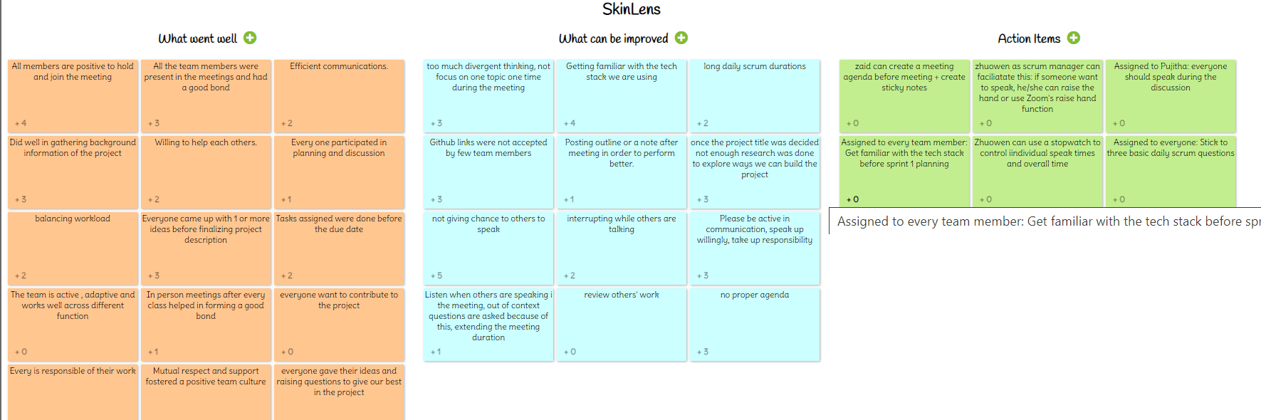
SPRINT RETROSPECTIVE

Slide 19
Few important points from the Retrospective
What went well
All members Are positive to hold and join the meeting
Did well in the gathering background information of the project
Everyone came up with 1 or more ideas before finalizing project description
What can be improved
Get familiar with the tech stack we are using
Not giving chance to other to speak
Too much divergent thinking ,not focus on one topic at one time during the meeting
Action Items
- Zaid can create a meeting agenda before meeting starts
Zhuowen as scrum master can facilitate this if someone want to speak ,he or she can raise the hand or use the zoom’s raise hand function
Assign to everyone stick to the three basic daily scrum question

Slide 20

WIKI PAGE LINK
To see our progress
https://github.com/htmw/2024F-Biased/wiki

Slide 21
THANK YOU
TEAM BIASED

